Slide 1
Weather and Particle Monitoring System
By,
Group 2

Slide 2
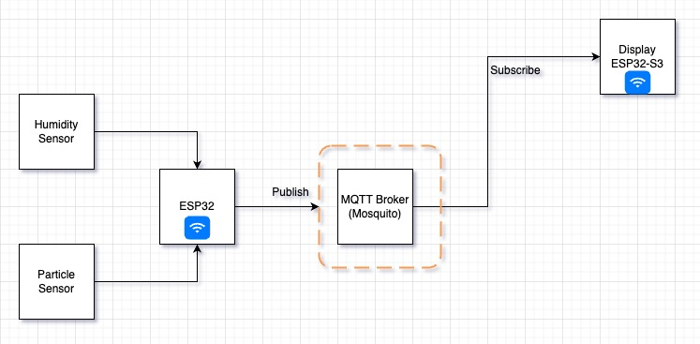
Architecture Diagram

Slide 3
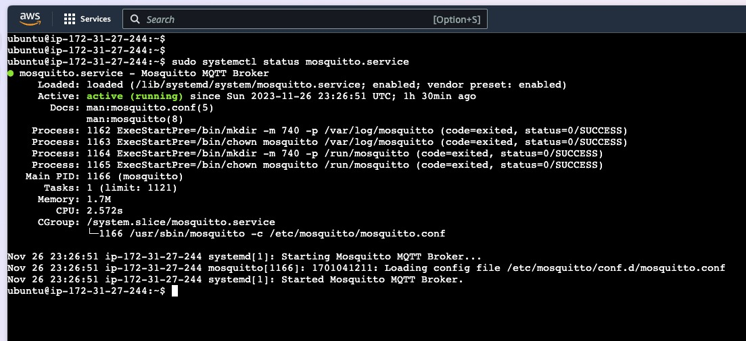
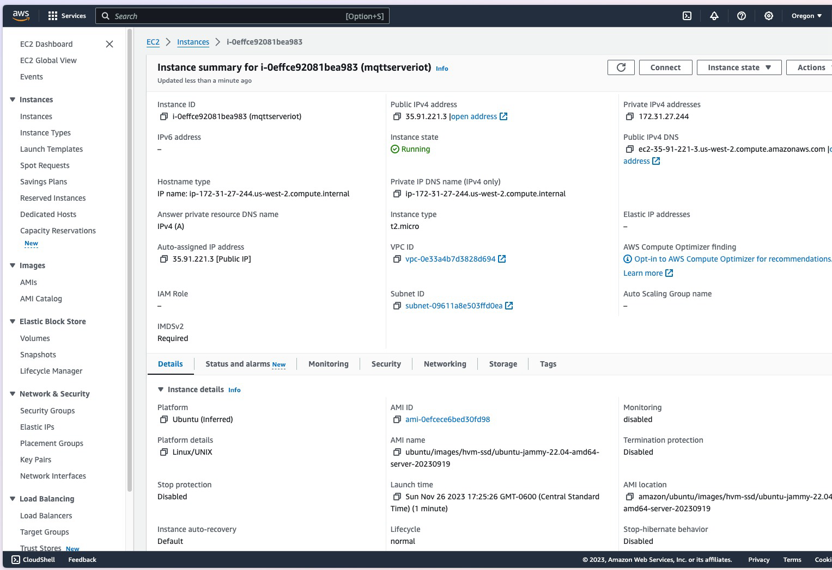
Mosquito and AWS Server

Slide 4
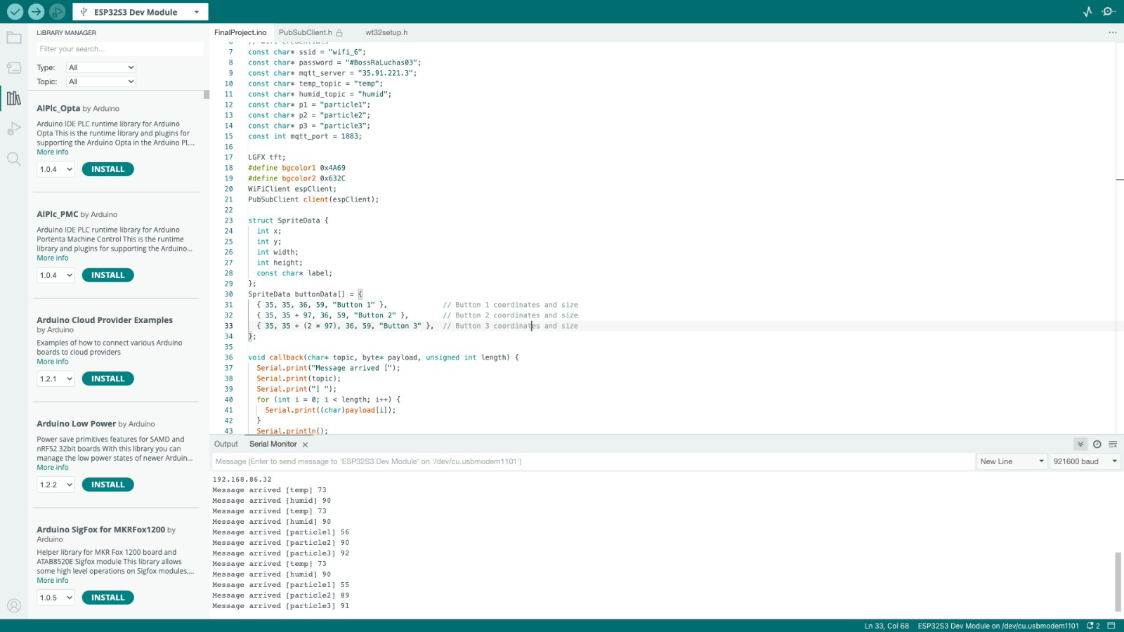
Temperature sensor

Slide 5
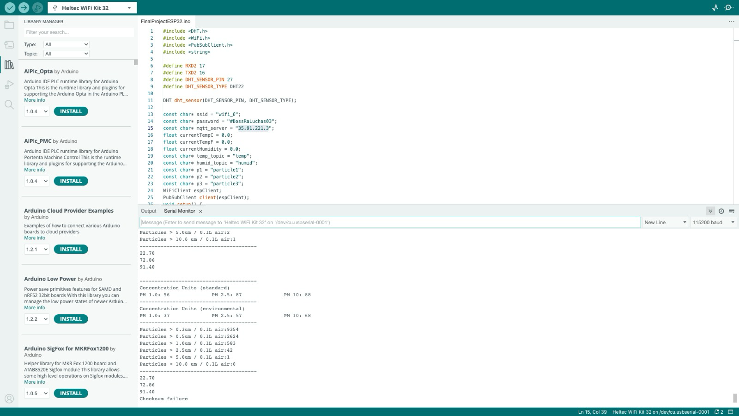
Particle Sensor values

Slide 6
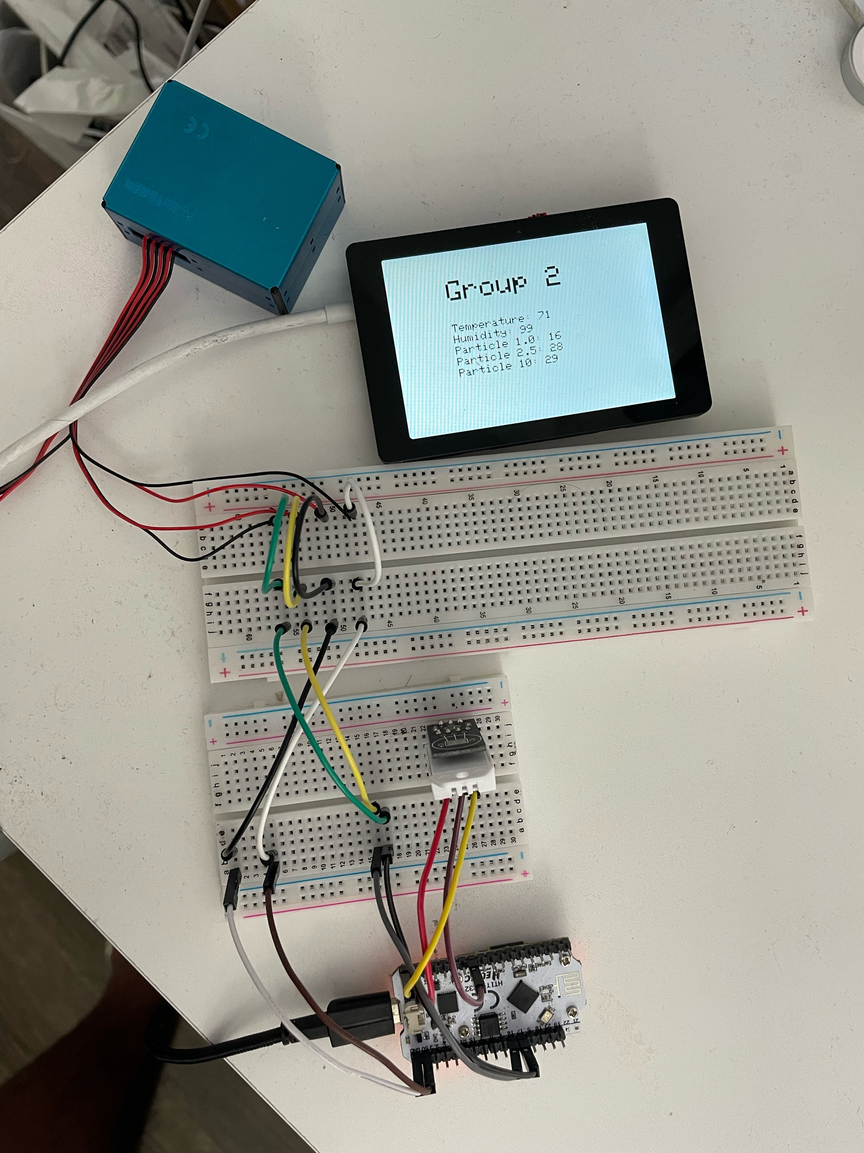
Screen

Slide 7
